Slide 1
Electric Motor Temperature Prediction.
Data Science Excelr Project - P189.

Slide 2
Group Members-
Ankit Indorkar
Shreyas Sadavarte
Bhimaraj Tagadagar
Kunal Mhaske
Meenal Patel
Radhika jadhav
Neha Chavan

Slide 3
Business Objective :-
Predict Motor Speed based on other attributes available
The dataset comprises several sensor data collected from a permanent magnet synchronous motor (PMSM) deployed on a test bench. The PMSM represents a ccTest bench measurements were collected by the LEA department at Paderborn University. This dataset is mildly anonymized.
All recordings are sampled at 2 Hz. The dataset consists of multiple measurement sessions, which can be distinguished from each other by the column "profile_id". A measurement session can be between one and six hours long.
The motor is excited by hand-designed driving cycles denoting a reference motor speed and a reference torque. Currents in d/q-coordinates (columns "i_d" and i_q") and voltages in d/q-coordinates (columns "u_d" and "u_q") are a result of a standard control strategy trying to follow the reference speed and torque. Columns "motor_speed" and "torque" are the resulting quantities achieved by that strategy, derived from set currents and voltages.
Most driving cycles denote random walks in the speed-torque-plane in order to imitate real world driving cycles to a more accurate degree than constant excitations and ramp-ups and -downs would.

Slide 4
Understanding the features-
Motor speed: This is the target variable that you are trying to predict, so it would be important to consider how it is related to the other features in the dataset.
Current d-component (i_d) and current q-component (i_q): These features may be important because they are related to the torque induced by current, which could have an impact on the motor speed.
Voltage d-component (u_d) and voltage q-component (u_q): Similarly to current, these features may also be important because they are related to the control strategy used to achieve the reference speed and torque, which could have an impact on the motor speed.
Ambient temperature (ambient) and coolant temperature (coolant): These features may be important because temperature can have an impact on the performance of the motor.
Permanent Magnet surface temperature (pm), stator yoke temperature (stator_yoke), stator tooth temperature (stator_tooth) and stator winding temperature (stator_winding) : They could be important to consider the temperature of the different parts of the motor because it can have an impact on the performance of the motor.

Slide 5
Approach towards the Problem-
It is not to say that all of the features will be important, but they can have an impact on the motor speed.
To select the most important features, we can use feature selection techniques like correlation, mutual information, univariate feature selection, and tree-based feature selection methods.These methods will help us to identify the features that have the most impact on the target variable.
In this particular project, it may be important to consider the features that are most closely related to the motor speed. Some features that could potentially be important include:
The standard approach for this regression problem would be to use a machine learning model to make predictions about the motor speed based on the other attributes in the dataset. The process typically involves the following steps:

Slide 6
Exploratory Data Analysis Over Temperature dataset.
While Beginning with the EDA, we addressed both Qualitative and Quantitative issues with the data given, which includes Identifying the null values, dropping out the duplicates, handling the missing values and dealing with the Outliers.
We succeeded in Validating data through EDA over the given dataset which is now ready for model building.
We did not perform the Label Encoding and One Hot Encoding as data is already in the numeric format.
Following are the visualisations and Inferences we carried out after performing EDA.

Slide 7
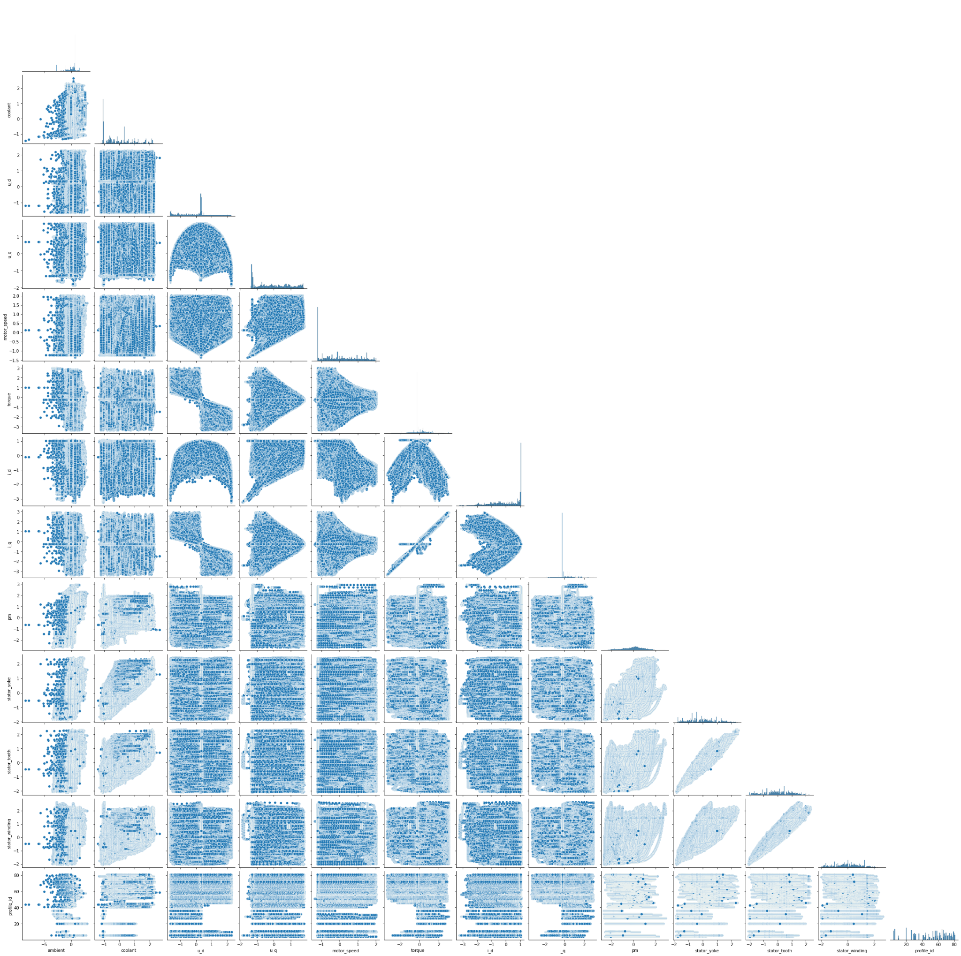
Pair Plot Over the complete dataset.

Slide 8
Inferences based on the pair plot-
There is a linear relationship between i_q (current d-component) and torque (torque induced by current).
We can also find Distance correlation in between motor speed, u_q (voltage q-component), u_d (voltage d-component), i_q (Current q-component), i_d(current d-component).
There is also a linear correlation between, stator_yoke, stator_tooth, stator_winding.

Slide 9
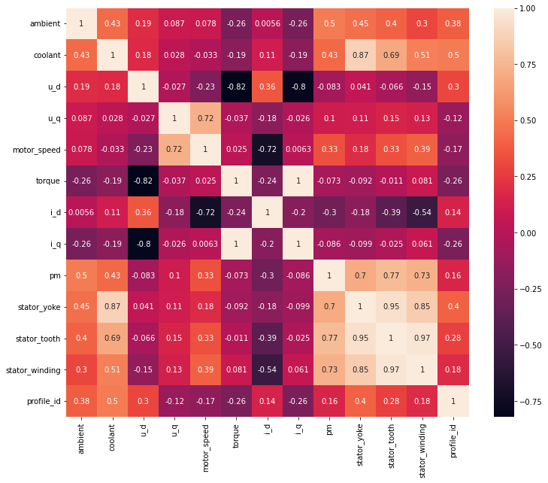
Heat Map which represents Collinearity in Numbers-

Slide 10
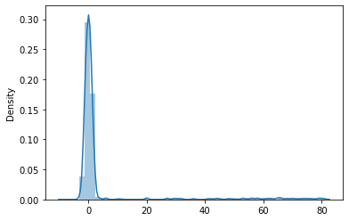
Above is the Distribution plot of the dataset. Here we identify that the data is Rightly Skewed.

Slide 11
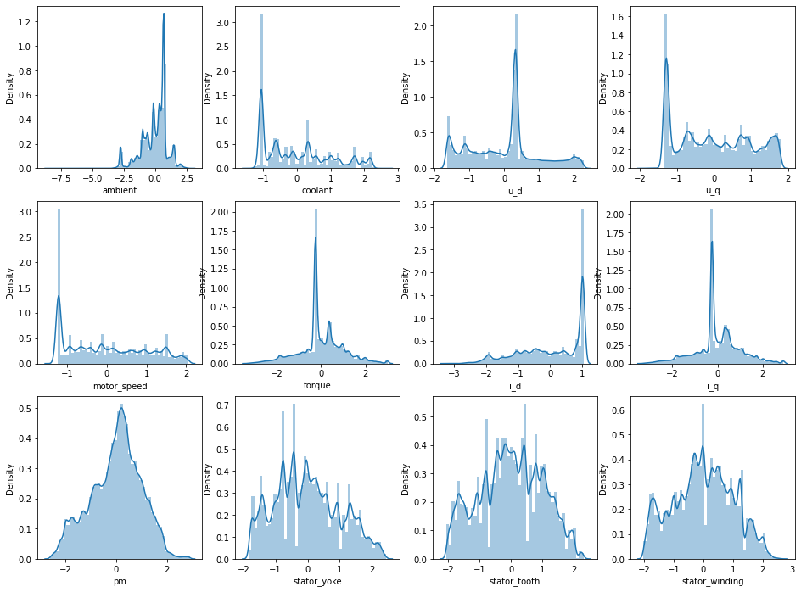
Density Plot over the Dataset- Here we can say that Permanent Magnet is normally distributed.

Slide 12
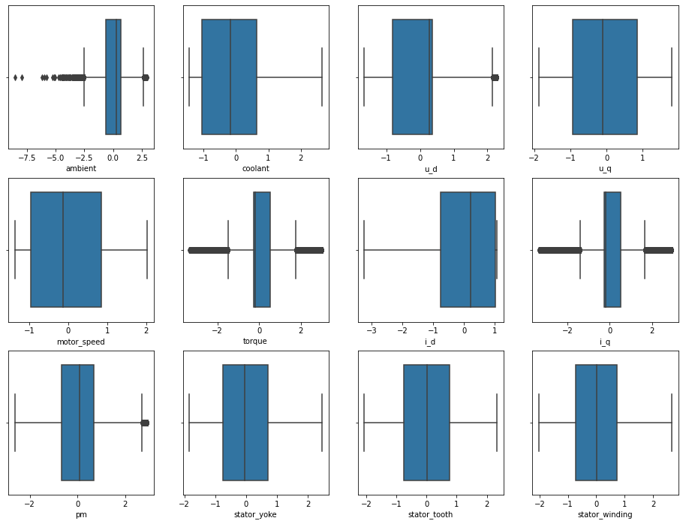
Above is the the Boxplot for Outlier Detection.

Slide 13
Inferences based on Boxplot-
Outliers can be detected in ambient (ambient temperature), u_d (voltage d-component), torque (torque induced by current), i_q (current d-component), pm (permanent magnet).

Slide 14
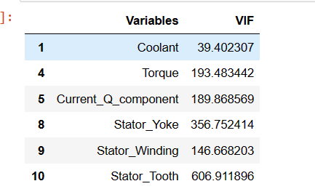
Calculating Variance Inflation Factor :-

Slide 15
Inferences based on VIF :-
Generally if we got VIF value more than 10 that indicates there is high correlation with the other independent variables.
We calculated VIF for all the variables and selected variables those having VIF value more than 10.
Namely we got 6 variables that are coolant, torque, current_q_component, stator_yoke, stator_winding, stator_tooth.
We are going to consider those 6 variables as above mention.

Slide 16
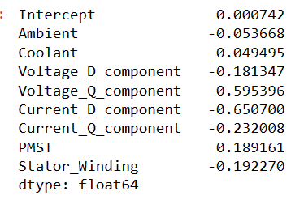
Model Building 1) Linear Regression :-
Coefficient Of Variables Using Selected Features :-

Slide 17
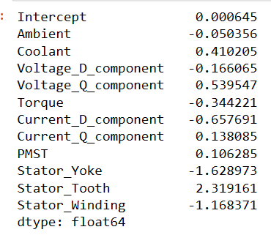
Coefficient Of Variables Using All Features :-

Slide 18
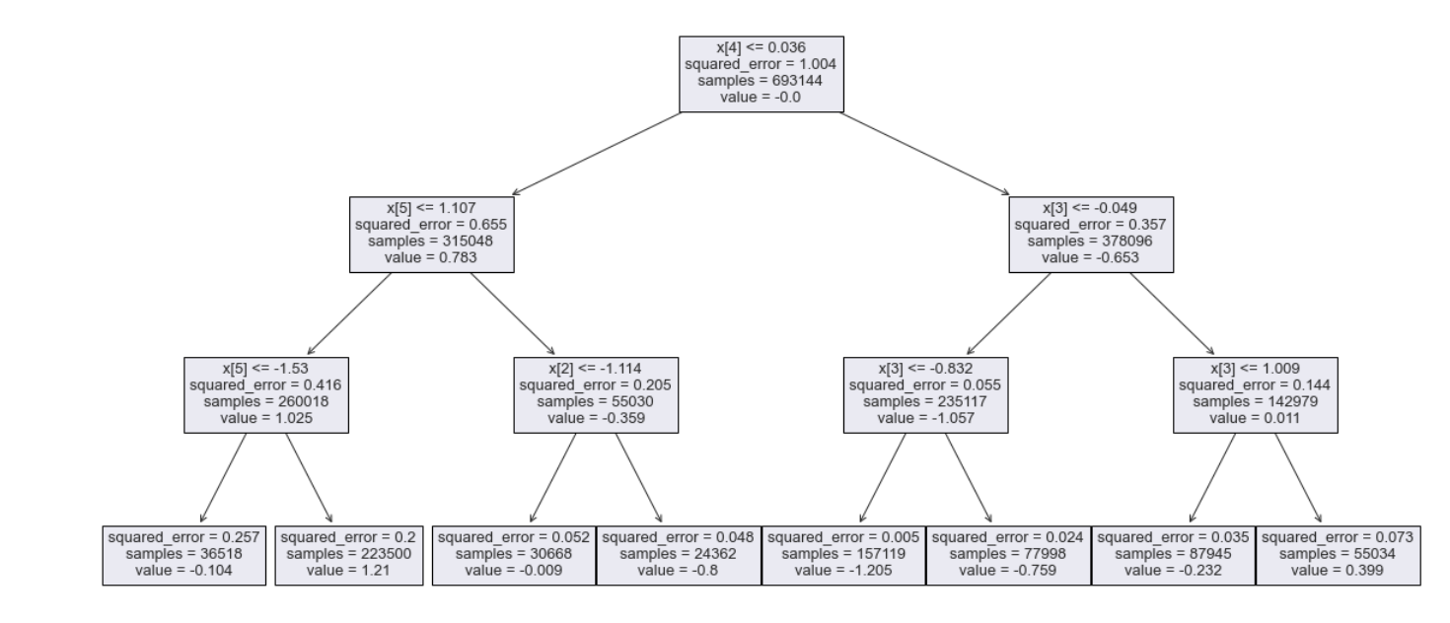
2) Decision Tree Model :-

Slide 19
Inferences based on Decision Tree :-
Mean Squared Error value is 0.0953
As the value of MSE is very small we can say that the model is performing better because Lower MSE indicates better performance.
Mean Absolue Error is 0.21745
As the value of MAE is 0.12 we can say that the model is performing better because Lower MAE indicates better performance.
R-Squared Value is 0.905109
As R-squared value ranges from 0 to 1, where 1 indicates a perfect fit, and values closer to 1 indicate better performance so our value is 0.90 means it is a good one and our model is performing better.

Slide 20
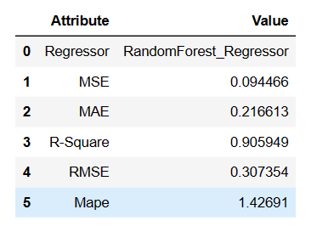
3) Random Forest Model :-
Mean Squared Error value is 0.09446
Mean Absolute Error value is 0.21661
R-Squared Error vaule is 0.90594
RMSE value is 0.30735
MAPE value is 1.42690

Slide 21
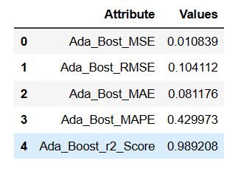
4) Ada Boost Regression Model-
Mean Square Error is 0.010839
Root Mean Square Error is 0.104112
Mean Absolute Error is 0.081176
Mean Absolute Percentage Error is 0.429973
R-Square Score is 0.989208

Slide 22
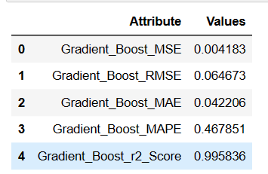
5) Gradient Boost Regression Model :-
Mean Square Error is 0.004183
Root Mean Square Error is 0.064673
Mean Absolute Error is 0.042206
Mean Absolute Percentage Error is 0.467851
R-Square Score is 0.995836

Slide 23
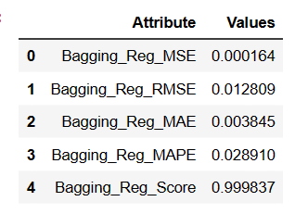
6) Bagging Regression Model :-
Mean Square Error is 0.000164
Root Mean Square Error is 0.012809
Mean Absolute Error is 0.003845
Mean Absolute Percentage Error is 0.028910
R-Square Score is 0.999837

